Slide 1
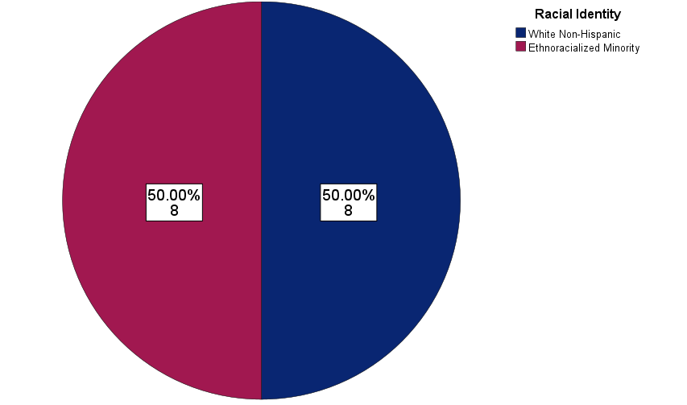
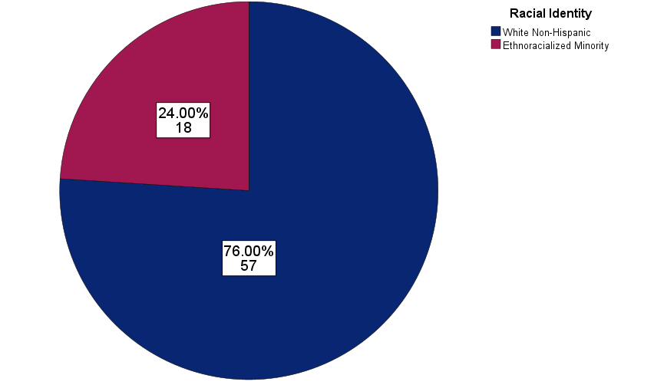
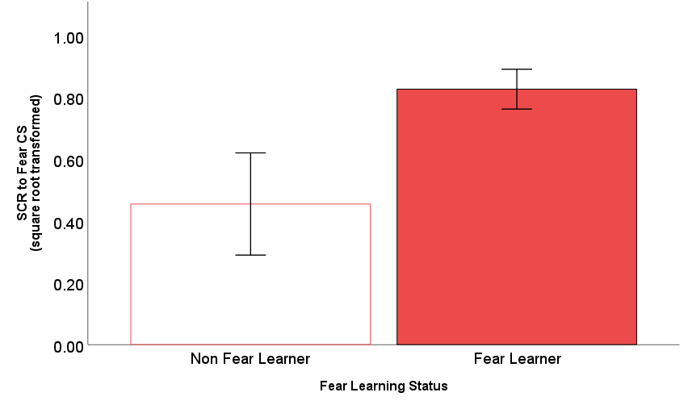
Sociodemographic Correlates of Learned Fear:
Preliminary Results from a Conditional Fear, Reward, and
Neutral Discrimination Task
Louis Zielinskiª, Téa Grahamª, E. Kate Webb^{b}, Susan Sangha^{c}, Jacklynn M. Fitzgeraldª
INTRODUCTION
METHODS
RESULTS
Contingency awareness — recognizing that a conditioned stimulus (CS) predicts threat — is critical for conditioned fear responses. ¹
Yet only some research has examined sociodemographic differences in contingency awareness of learned fear.
Prior limited work that has examined this found that ethnoracial minoritized individuals exhibit less conditioned fear.
To build upon this work, this study examined sociodemographic correlates of a learned fear response, quantified by self-reported awareness of a conditioned fear cue’s association with threat. Subsequently, we examined if lack of awareness was related to reduced fear arousal response.
Participants (N = 93) completed the Fear, Reward, and Neutral Discrimination (FRND) task ²
FIGURE 2
Geometric shapes (conditioned stimuli [CS]) were paired with unconditioned stimuli (US) - aversive noise (Fear), $0.25 (Reward), or no outcome (Neutral)
Participants were asked to rate their likeability of each CS on a Likert scale: 1= very bad, 5 = neutral, 9 = very good
Likeability ratings: individuals who rated the fear cue < neutral were classified as learners
FIGURE 1
Ethnoracial minoritized individuals comprised 29% of the sample but were disproportionately represented as non-fear learners
(50% of non-fear learners) (p = 0.037)
FIGURE 3
Skin conductance responses (SCRs) were recorded as a measure of physiological arousal to the CS (> 0.03 µS 1-3 seconds after CS onset)
Being a non-fear learner was associated with reduced SCR to conditioned fear CS (p = 0.023) but fear learning status did not moderate the relationship between race and SCR to conditioned fear cues (p = .16).
ª Translational Affective Neuroscience Lab, Department of Psychology, Marquette University
^{b} Department of Psychiatry & Behavioral Sciences, Duke School of Medicine
^{c} Department of Psychiatry, Indiana University School of Medicine; Stark Neuroscience Research Institute
Statistical Analyses:
Chi-square and independent samples t-tests were used to examine sociodemographic differences based on fear learning status.
An independent samples t-test was used to test differences in SCR to conditioned fear cues between fear vs. non-fear learners.
A moderated linear regression tested whether fear learning status moderated the relationship between significant sociodemographic predictors and SCR to conditioned fear cues.
REFERENCES
CONCLUSIONS
Baeuchl, C., Hoppstädter, M., Meyer, P., & Flor, H. (2018). Contingency awareness as a prerequisite for differential contextual fear conditioning. Cognitive Affective & Behavioral Neuroscience, 19(4), 811–828.
Fitzgerald, J. M., Webb, E. K., & Sangha, S. (2023). Psychological and physiological correlates of stimulus discrimination in adults. Psychophysiology, 60(10).
Kredlow, M. A., Orr, S. P., & Otto, M. W. (2018). Who is studied in de novo fear conditioning paradigms? An examination of demographic and stimulus characteristics predicting fear learning. International Journal of Psychophysiology, 130, 21–28.
Harnett, N.G., Wheelock M.,D., Wood, K.H., Goodman, A.M., Mrug, S., Elliot, M., Schuster M., Tortolero S., Knight, D.C. (2019). Negative life experiences contribute to racial differences in the neural response to threat. Neuroimage, 202, 116086
Results support limited prior work that also found ethnoracial minoritized individuals experienced less fear response in lab settings. ³
Critically, prior work suggests that these effects are driven by lived experiences⁴; work is underway to investigate the role of discrimination, stress, and trauma in shaping these differences in learned fear responses

