Slide 1

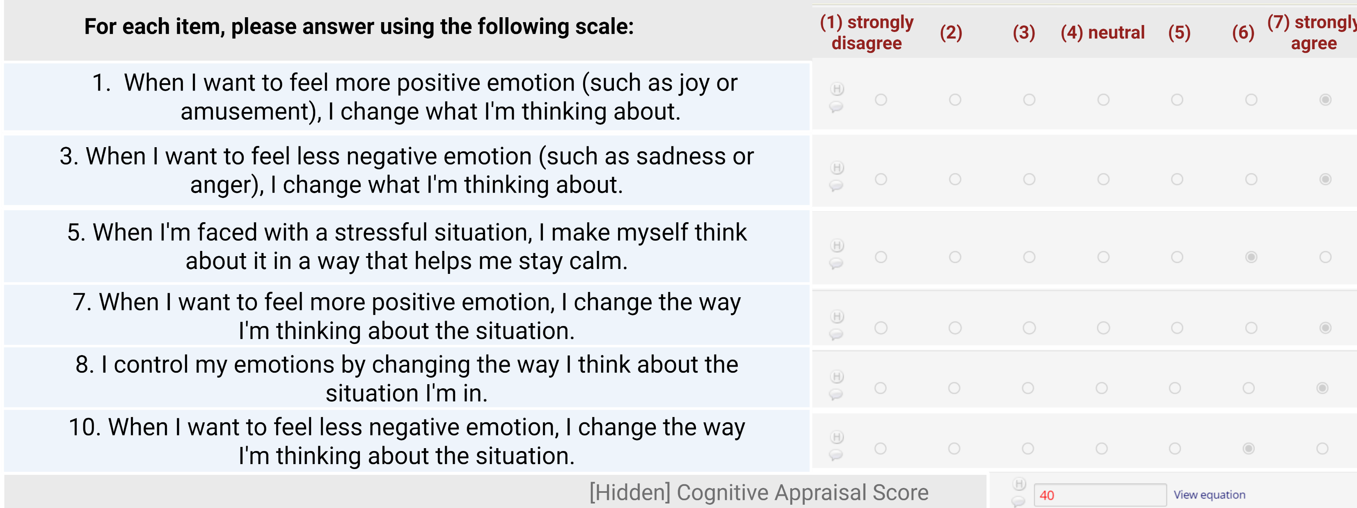
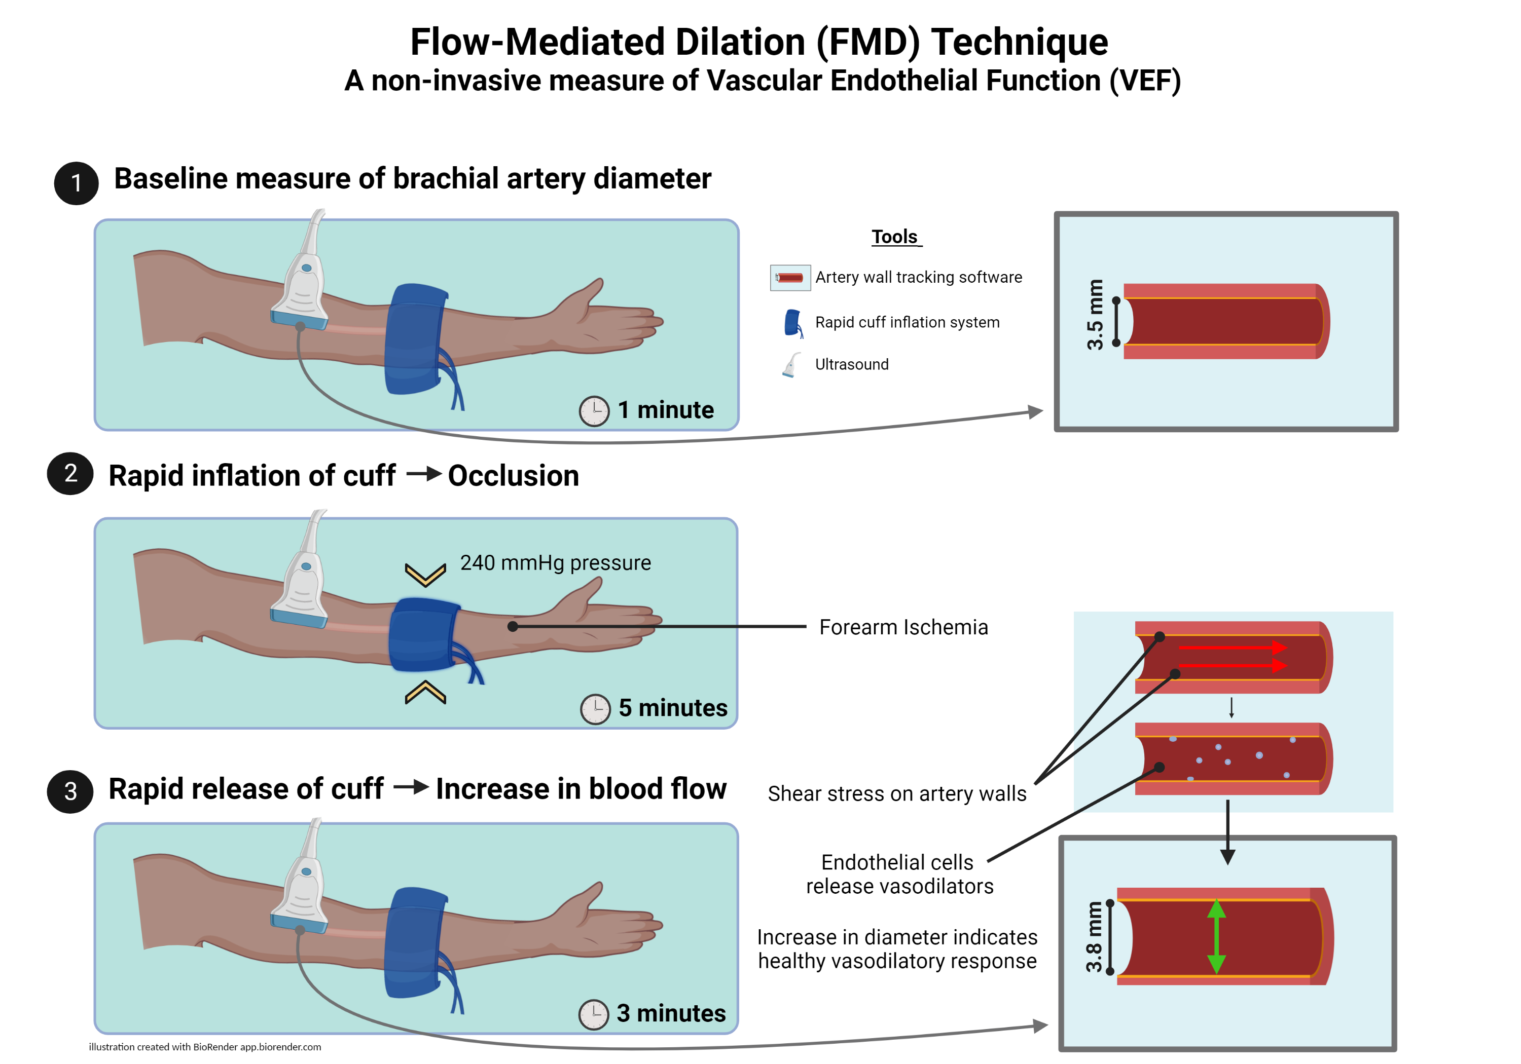
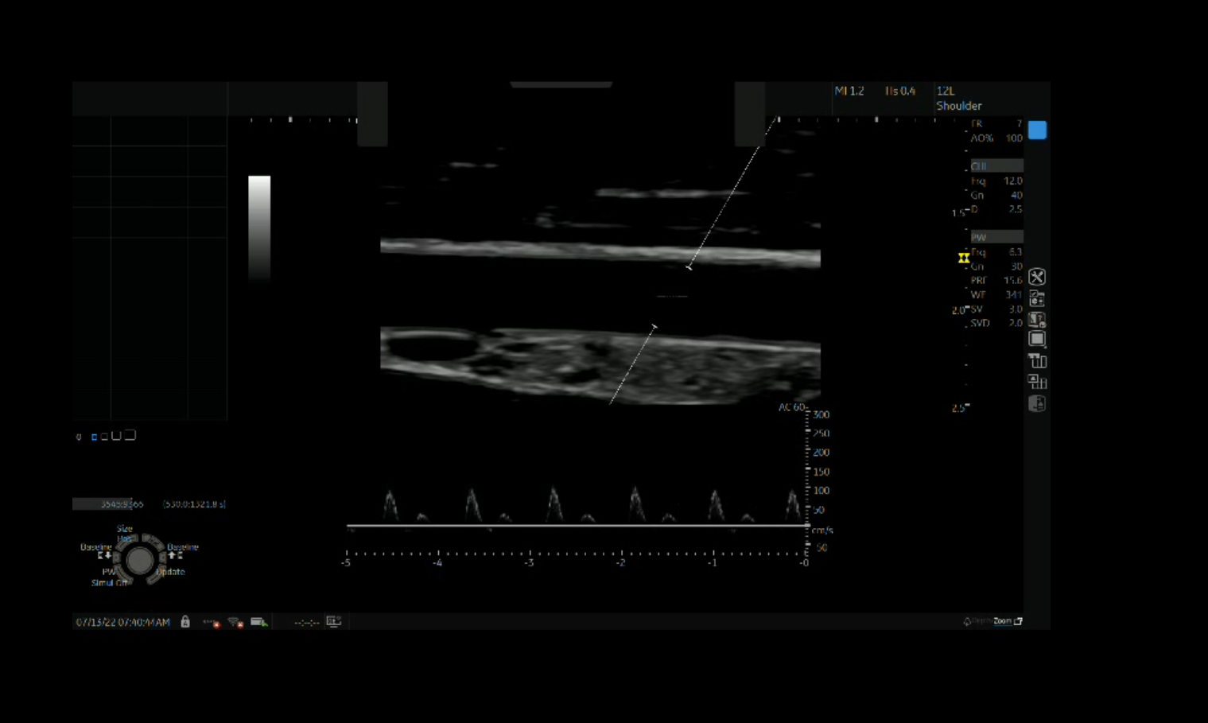
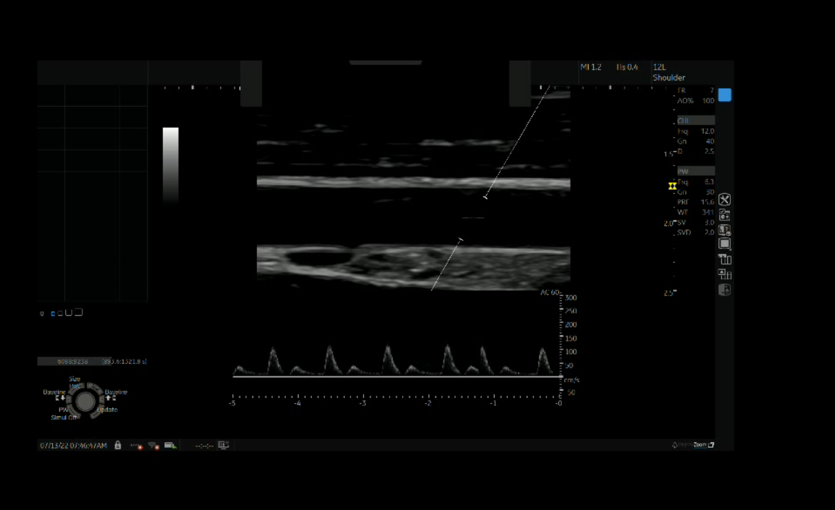
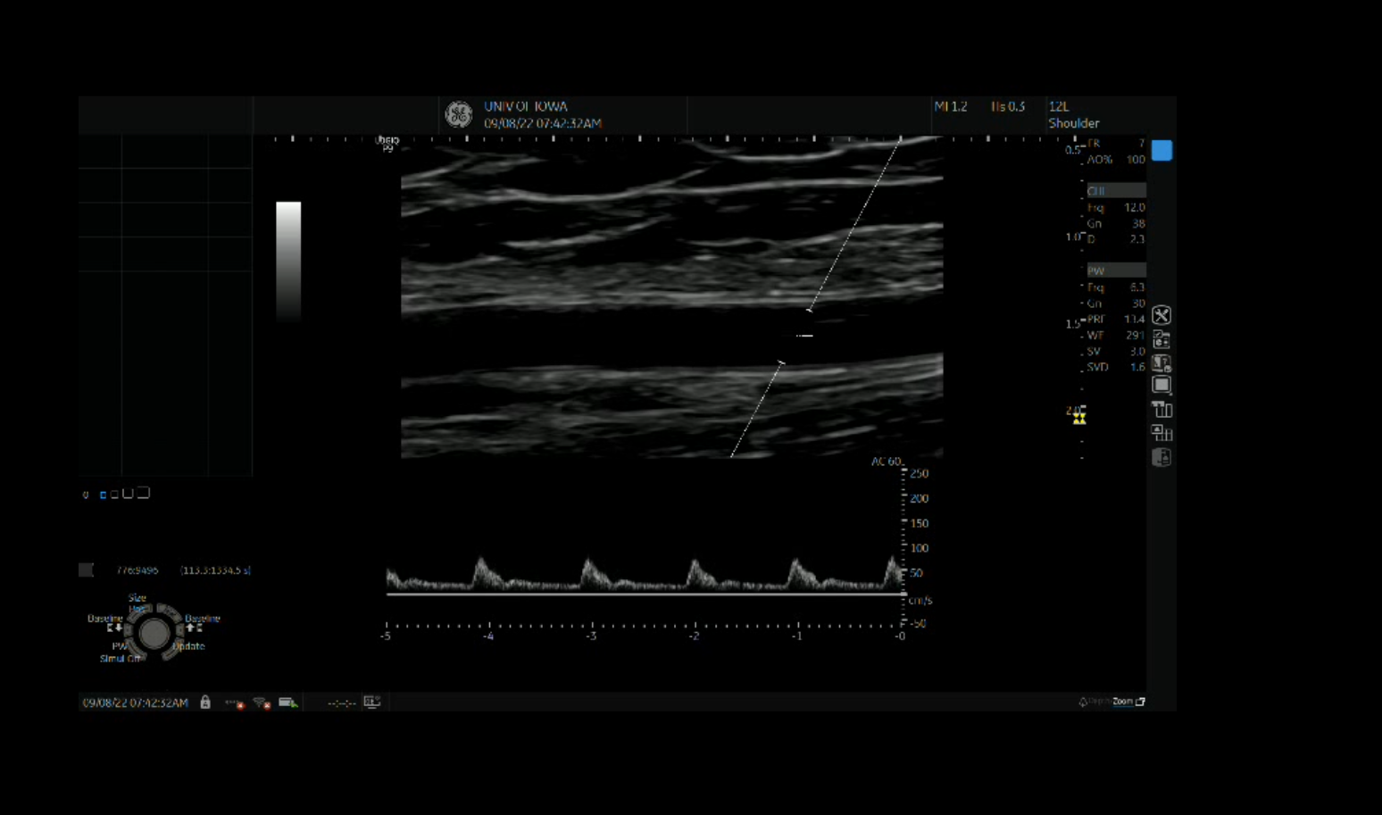
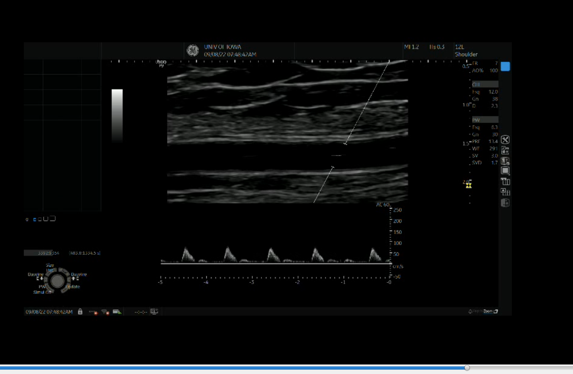


Cognitive Reappraisal may be a Modifiable Target to Improve Vascular Function in Young Adults with Adverse Childhood Experiences: A Cross-Sectional Pilot Study
Laura E. Schwager¹, Emily B.K. Thomas², Kylee S. West¹, Thomas W. Hart¹, Nathaniel D.M. Jenkins¹
¹University of Iowa Department of Health and Human Physiology; ²University of Iowa Department of Psychological and Brain Sciences
Background
Results
p=
Individuals with exposure to Adverse Childhood Experiences (ACEs) are at increased risk for developing cardiovascular diseases, the leading cause of premature death in the United States.
Vascular endothelial function was significantly lower in those with high ACE exposure.
Cognitive reappraisal was moderately lower, though the difference was not significant.
Reduced vascular endothelial function is a subclinical, pathophysiological mechanism contributing to cardiovascular disease among individuals with high ACE exposure.
Psychological factors, such as emotional regulation, may be related to vascular endothelial function.
Sample Characteristics
 | High ACE group (n=12) |  |  | No ACE Group (n=12)
 | n | % |  | n | %
Sex
Female | 8 | 67 |  | 8 | 67
Male | 4 | 33 |  | 4 | 33
Race
White | 5 | 42 |  | 9 | 75
Asian / PI | 2 | 17 |  | 1 | 8
Biracial | 2 | 17 |  | 1 | 8
Black | 1 | 8 |  | 1 | 8
Other | 2 | 17
 | Mean | SD | Range | Mean | SD | Range
Age | 24 | 3 | 19 – 29 | 22 | 3 | 19 – 27
Height (cm) | 167 | 10 | 158 – 187 | 173 | 9 | 155 – 185
Weight (kg) | 62.0 | 13.6 | 45.4 – 94.7 | 67.2 | 12.7 | 42.3 – 85.1
BMI | 22.0 | 3.7 | 17.7 – 29.5 | 22.3 | 3.2 | 17.6 – 28.2
ACE Score | 5.4 | 1.5 | 4 – 8 | 0 | 0
Cognitive Reappraisal Score | 28 | 7.8 | 12 – 41 | 33 | 6.0 | 20 - 42
FMD baseline diameter (mm) | 3.1 | 0.7 | 2.3 – 4.7 | 3.2 | 0.5 | 2.3 – 3.9
FMD %∆ from baseline (%) | 4.9 | 2.6 | 1.8 – 10.2 | 8.1 | 2.7 | 4.7 – 14
Purpose
To investigate the relationship between Cognitive Reappraisal, a key component of emotional regulation, and vascular endothelial function
in healthy young adults both with and without ACEs.
Methods
In 24 healthy young adults (Table 1), we measured:
ACE exposure using the 10-item ACE Questionnaire
Scores range 0 – 10 │ Enrolled No ACE (0 ACEs) and High ACE (≥4 ACEs) individuals
a
Cognitive Reappraisal using the Emotional Regulation Questionnaire (ERQ-S) (Fig. 1)
Scores rang 6 – 42 │ Higher score = Greater capacity to use cognitive reappraisal as an emotional regulation strategy
a
Vascular endothelial function using the Flow-Mediated Dilation technique (Fig. 2 - 3)
Figure 4. Results of independent samples t-test between High ACE and No ACE groups. FMD (as % change from baseline diameter) was significantly lower (–3.2±1.1%; p=0.007; g=1.1) in the High ACE group, with a large effect size.
Table 1. Characteristics of sample (n=24) by ACE group. The No ACE group (n=12) was defined as 0 ACEs. The High ACE group (n=12) was defined as 4 or more ACEs.
Figure 5. Results of independent samples t-test between High ACE and No ACE groups. Cognitive Reappraisal was moderately lower (–5.1±2.8 a.u.; p=0.090; g=0.67) in the High ACE group, but the difference was not significant.
Cognitive Reappraisal was significantly associated with vascular endothelial function
in both the whole sample and the High ACE group.
Figure 1. Questions included in the Cognitive Reappraisal Score from the ERQ-S (Preece et al. 2023).
p = 0.001
r = 0.59
p = 0.052
r = 0.49
p = 0.040
r = 0.53
Figure 6. Results of Pearson’s correlations between Cognitive Reappraisal (a.u.) and Flow Mediated Dilation (FMD, as % change from baseline diameter) in the whole sample (n=24) and in the High ACE (n=12) and No ACE (n=12) groups. Cognitive Reappraisal was positively associated with FMD in the whole sample (r=0.59, p=0.001) and High ACE group (r=0.53, p=0.040) , and was not significantly associated in the No ACE group (r=0.49, p=0.052).
Conclusions
Figure 2. Illustration of FMD technique to measure vascular endothelial function.
As expected, young apparently healthy adults who had high exposure to adverse childhood experiences have lower vascular endothelial function, a risk factor for developing cardiovascular disease. They also tend to have lower Cognitive Reappraisal scores.
A higher tendency to reframe negative emotional experiences as an emotional regulation strategy, measured via Cognitive Reappraisal score,
is associated with greater vascular function independent of ACE exposure.
Since cognitive reappraisal is a key component of cognitive-behavioral therapy (CBT), intervention studies are needed to determine whether CBT can improve capacity for cognitive reappraisal and improve vascular endothelial function.
A)
Post-occlusion increase in diameter
within healthy range
B)
Baseline
Post-occlusion
Post-occlusion increase in diameter
under healthy range
This study was limited by a small sample size and inability to determine causality due to its cross-sectional design.
Contact Lead Author:
laura-schwager@uiowa.edu
Contact Principal Investigator:
nathaniel-jenkins@uiowa.edu
Connect with our lab
Baseline
Post-occlusion
This study was supported by funding from the
University of Iowa Early Career Scholar of the Year award (University of Iowa, NDMJ).
Figure 3. Comparison of brachial artery ultrasound images before and after occlusion in the FMD procedure.

